Slide 1
Introduction
Anab Batool Kazmi

Slide 2
Theory of Computation/Theoretical Computer Science
The theory of computation is the branch of computer science that deals with how efficiently problems can be solved on a model of computation, using an algorithm.
A model of computation is the definition of set of allowable operations used in computation and their respective costs.
describes how a set of outputs are computed given a set of inputs.
describes how units of computations, memories, and communications are organized.
It is used for measuring the computational complexity of the problem for which it is designed.

Slide 3
Theory of Computation
Abstract away as many specifics as we can
All machines are different but basics of computation model remains the same.

Slide 4
Theory of Computation
This field is divided into three major branches:
Automata Theory and Language
How can we mathematically model computation?
Computability Theory
What problems can be solved by a computer?
Complexity Theory
What makes some problems computationally hard and others easy?

Slide 5
Automata Theory
Automata Theory is a branch of computer science that deals with designing abstract self-propelled computing devices that follow a predetermined sequence of operations automatically.
The word “Automata” is plural of “automaton” which simply means any machine.
A machine that operates on its own (automatically) without the need for human control.
These machines need not to be a physical hardware.

Slide 6
Contd.
Through automata, computer scientists are able to understand
how machines compute functions and solve problems.
What the computer machine could do and what it could not do.
In automata we will simulate parts of computers.

Slide 7
Contd.
Helps in design and construction of different software's and what we can expect from our software's.
Automata play a major role in theory of computation, compiler design, artificial intelligence.

Slide 8
Families of Automaton
Deals with the definitions and properties of mathematical model of computation.
Example:
Finite Automata (Simplest)
Text Processing
Compilers
Context Free grammars
Programming languages
AI

Slide 9
Questions
How does the Computer interpret input given by input devices? And How does it ﬁnd commands and then carry out appropriate actions.?
How does computers read and interpret ﬁles, for example when it comes to compiling a program from a language such as Java, C or ML?
How does Compilers recognize keywords like if or else?
How does the search engine searches the keyword or phrase entered by the user?
How does the search engine recognizes diﬀerent forms, of string such as type, typing and typed?

Slide 10
Questions
How do online shopping assistants work? They ﬁnd a given product at various shops and tell you what it costs. How do they extract the information, in particular since some of the pages describing the product are created on demand only?
Imagine you had to write a piece of code that accepts a string as an input and checks whether this string could be a valid email address.
Imagine you had to write a program that goes through a number of emails in a folder and returns all the subject lines for those (every email client has a way of doing this, of course). How would you do that?

Slide 11
Questions
Imagine you had to write a program that goes through a bunch of documentation ﬁles and checks whether they contain any double typed words (such as ‘the the’). This is a very common mistake, and a professional organization would want to remove these before delivering the software to a customer.

Slide 12
Contd.
What if
Your program had to work across lines (and an arbitrary number of spaces)?
You had to take into account that the ﬁrst doubled word might be capitalized?
The two doubled words might be separated by html tags?

Slide 13
Contd.
Imagine you had to write code for a vending machine that takes coins and in return delivers variously priced goods. How does the machine keep track of how much money the user has put in so far, and how to produce correct change from the coins it holds? It’s your job to keep track of all the cases that may arise.

Slide 14
Contd.
Imagine you had to write a piece of code that takes as input a ﬁle containing a Java program and checks whether the curly brackets {} are all properly balanced.

Slide 15
Characteristics of machines
A typical abstract machine consists of:
Inputs
Sequences of symbols selected from a finite set ∑ of input signals.
Set ∑ is the set {x₁, x,₂, x₃... x_{k}} where k is the number of inputs.
Outputs
Sequence of symbols selected from finite set Z.
set Z is the set {y₁, y₂, y₃ ... y_{m}} where m is the number of outputs
States
Finite set Q, whose definition depends on type of automaton.

Slide 16
Cont.
Automatons are abstract models of machines that perform computations on an input by moving through a series of states or configurations.
At each state of the computation, a transition function determines the next configuration on the basis of a finite portion of the present configuration.
As a result, once the computation reaches an accepting configuration, it accepts that input.

Slide 17
A simple computer
SWITCH
BATTERY
input: switch
output: light bulb
actions: flip switch
states: on, off

Slide 18
A simple “computer”
SWITCH
f
BATTERY
start
on
off
f
input: switch
output: light bulb
actions: f for “flip switch”
states: on, off
bulb is on if and only if there was an odd number of flips

Slide 19
Important Concepts in Automata

Slide 20
Introduction to Language
Automata deals with language.
Language is combination of
Alphabets (∑)
Grammar/Rules

Slide 21
Types of Languages
There are two types of languages
Formal Language
A language which can be represented mathematically.
Informal Language
A language which cannot be represented mathematically.

Slide 22
Symbol/Letter
A symbol is a building block for a string.
Symbols cannot be sub-divided, they are the atoms of everything we build.
In the theory of formal languages they are usually called letters. Examples: a, A, 0, 1, %, @.
We use letters from the end of the Roman alphabet, such as x, y, z to refer to an arbitrary symbol.

Slide 23
Alphabet (∑)
A finite non-empty set of symbols (called letters), is called an alphabet.
We use capital Greek letters, typically Σ ( Greek letter sigma), to refer to an arbitrary alphabet.
Example:
Σ= {A,B,C,…,Z,a,b,c,…,z}
Σ={0,1}
Σ={a,b,c}
Σ={ab,cd}
Σ={for,int,while}

Slide 24
Strings
Concatenation of zero or more finite number of letters/symbols from the alphabet is called a string.
Note that every letter can be viewed as a one-letter string.
We use letters s, t, u to refer to an arbitrary string.
Example:
Σ={a,b,c} then strings are
a, ab, aabbcc, abc, aaaabbbababa etc

Slide 25
Empty String/ Null String
Empty String is a string with no symbol i.e. 0 symbolwhich is denoted by
Small Greek letter Lambda (λ) or
Capital Greek letter Lambda (Λ)
Small Greek Letter Epsilon (ε)

Slide 26
Words
Words are strings belonging to some language i.e. having some meaning in that language
Example
Σ= {A,B,C,…,Z,a,b,c,…,z}
Strings : abc, def, ghi,…
Words : The, walk, intelligent , …
Note:
All words are strings, but not all strings are words.

Slide 27
Concatenation
Concatenation is the operation we perform on words (or letters) to obtain longer words.
When concatenating a with b we get ab, and we can concatenate that with the word ba to obtain abba.
If we concatenate 0 letters we get the word ε.
When we concatenate any word with the word ε we obtain the same word.

Slide 28
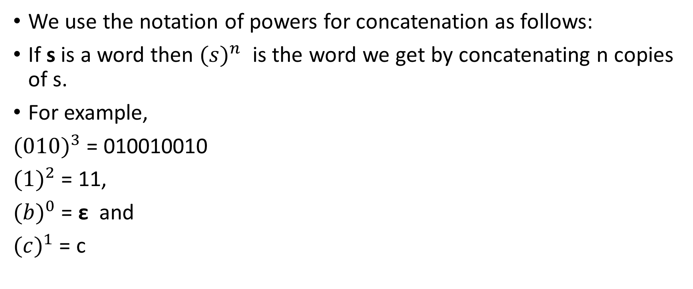
Powers
We use the notation of powers for concatenation as follows:
If s is a word then ${(s)}^{n}$ is the word we get by concatenating n copies of s.
For example,
${(010)}^{3}$ = 010010010
${(1)}^{2}$ = 11,
${(b)}^{0}$ = ε and
${(c)}^{1}$ = c

Slide 29
Powers of an alphabet
Let ∑ be an alphabet.
∑^{k} = the set of all strings of length k
Set of all strings
∑* = ∑⁰ U ∑¹ U ∑² U …
Set of all non empty strings
∑⁺ = ∑¹ U ∑² U ∑³ U …

Slide 30
Power of an alphabet
∑={0,1}
∑⁰ ={Λ} //strings of length 0
∑¹ ={0,1} // strings of length 1
∑² ={00,01,10,11} //strings of length 2
∑³ ={000,001,010,011, 100,101,110,111} //strings of length 3

Slide 31
String Tokenization
Tokenization is the act of breaking up a sequence of strings into piece such as words, keywords, phrases, symbols and other elements called token.
Example:
If Σ={a,b,c}
s= ababc
Tokenization = (a)(b)(a)(b)(c)
Σ={ab,cd}
s=abababcd
Tokenization= (ab)(ab)(ab)(cd)

Slide 32
Valid/Invalid Alphabet
While defining an alphabet of letters consisting of more than one symbols, no letter should be started with the letter of the same alphabet i.e. one letter should not be the prefix of another. However, a letter may be ended in a letter of same alphabet.
Σ₁= {B, aB, bab, d}
Σ₂= {B, Ba, bab, d}
Σ₁ is a valid alphabet while Σ₂ is an in-valid alphabet.

Slide 33
Example
Σ₂= {B, Ba, bab, d} and s=BBad
This string can be tokenized in two different ways.
(B)(Ba)(d)
(B)(B)(ad) cannot be identified as string of Σ₂

Slide 34
Valid/In-valid alphabets
As when this string is scanned by the compiler (Lexical Analyzer), first symbol B is identified as a letter belonging to Σ, while for the second letter the lexical analyzer would not be able to identify, so while defining an alphabet it should be kept in mind that ambiguity should not be created.
_{Note:}
Alphabet that cause ambiguity is not a valid alphabet.

Slide 35
Length of String
The length of string s, denoted by |s|, is the number of letters in the string.
Always positive.
Example
If Σ={a,b}
s= abba
Tokenization = (a)(b)(b)(a)
|s|= 4

Slide 36
Example Contd.
Σ={ab,bab}
s= abbabbababbab
Tokenization = (ab)(bab)(bab)(ab)(bab)
|s|= 5
Σ={for,int}
s= intforint
Tokenization = (int)(for)(int)
|s|= 3

Slide 37
Reverse of String
The reverse of a string s denoted by rev(s) or s^{r}, is obtained by writing the letters of s in reverse order.
First do tokenization then reverse the string.
Example
if s=abababc is a string defined over Σ={ab,c} then
Tokenization=(ab)(ab)(ab)(c)
|s|=4
rev(s)=cababab

Slide 38
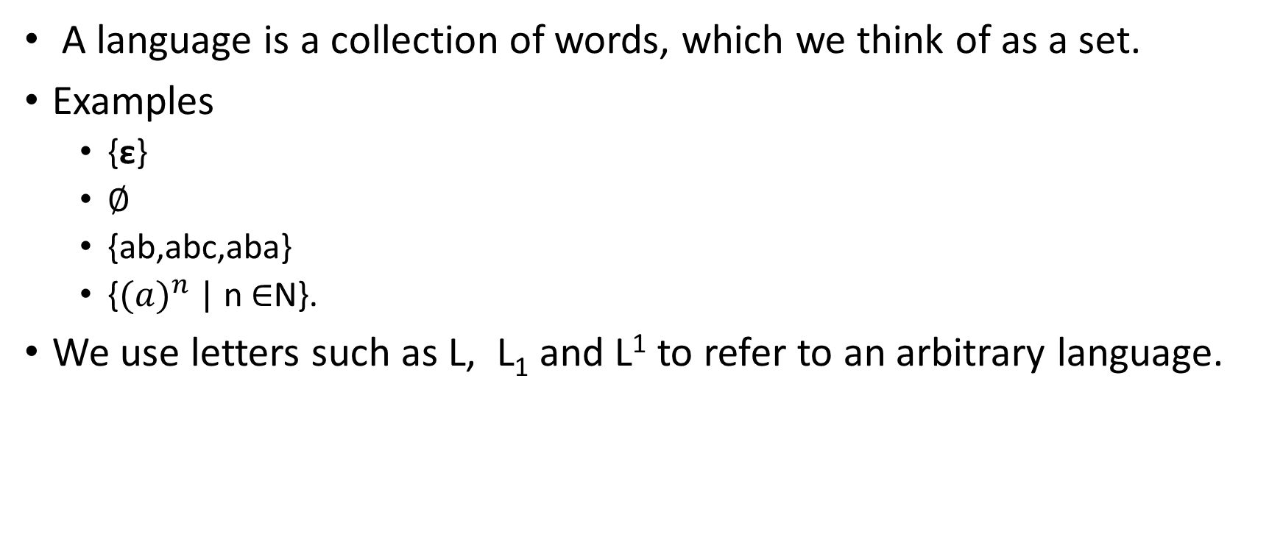
Language
A language is a collection of words, which we think of as a set.
Examples
{ε}
∅
{ab,abc,aba}
{${(a)}^{n}$ | n ∈N}.
We use letters such as L, L₁ and L¹ to refer to an arbitrary language.

Slide 39
Types of Languages
Single Letter Language
Language whose alphabet is having only one letter.
Σ={a}
Σ={b}
Σ={Λ}
Finite Language
Which generates countable strings
Infinite Language
Which generates infinite strings

Slide 40
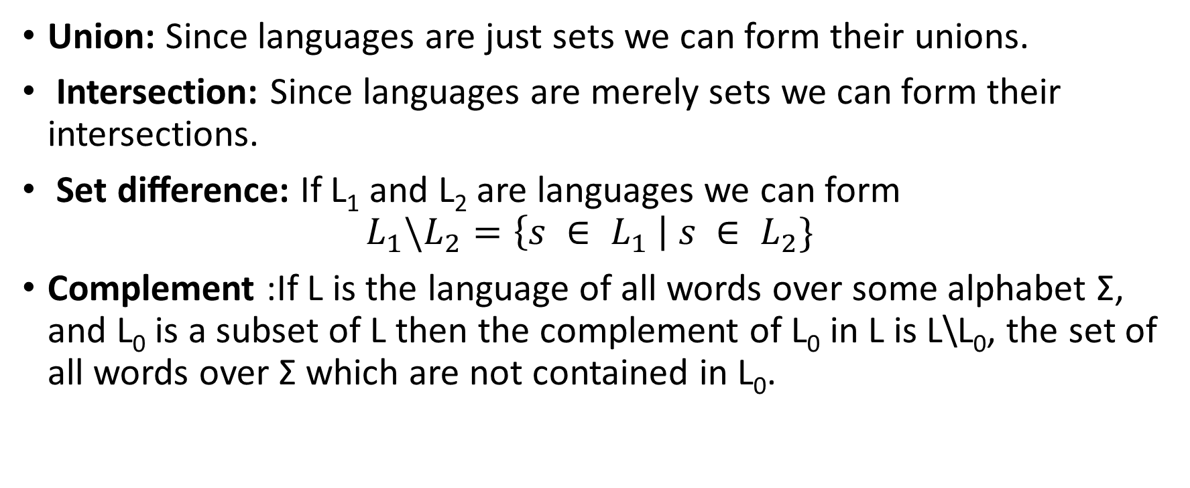
Deﬁning new languages from old ones
Union: Since languages are just sets we can form their unions.
Intersection: Since languages are merely sets we can form their intersections.
Set diﬀerence: If L₁ and L₂ are languages we can form
$$L_{1}\backslash L_{2}=\left\{s ∈ L_{1} \right| s ∈ L_{2}\}$$
Complement :If L is the language of all words over some alphabet Σ, and L₀ is a subset of L then the complement of L₀ in L is L\L₀, the set of all words over Σ which are not contained in L₀.

Slide 41

Deﬁning new languages from old ones
Concatenation: Because we can concatenate words we can use the concatenation operation to deﬁne new languages from existing ones by extending this operation to apply to languages as follows.
Let L₁ and L₂ be languages over some alphabet Σ. Then
$$L_{1}.L_{2}=\left\{s.t \right| s ∈ L_{1} and t∈ L_{2}\}$$

Slide 42
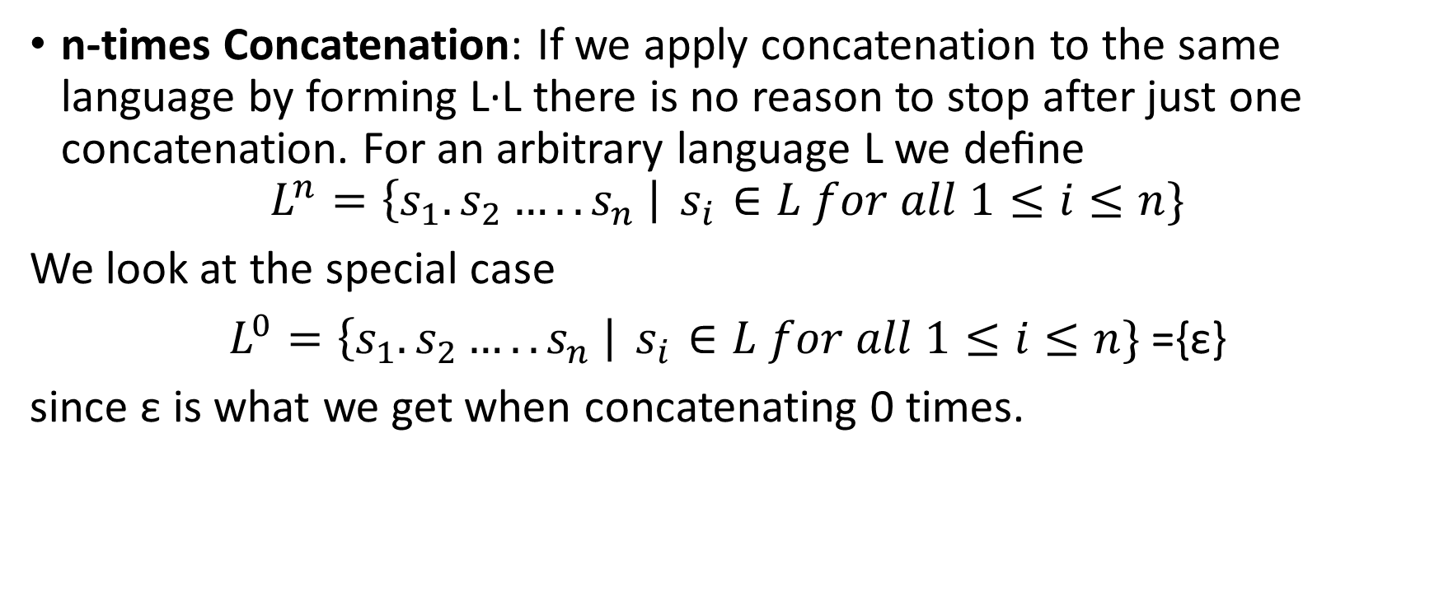
Deﬁning new languages from old ones
n-times Concatenation: If we apply concatenation to the same language by forming L·L there is no reason to stop after just one concatenation. For an arbitrary language L we deﬁne
$$L^{n}=\left\{s_{1}.s_{2}…..s_{n} \right|{ s}_{i} ∈L for all 1≤i≤n\}$$
We look at the special case
$L^{0}=\left\{s_{1}.s_{2}…..s_{n} \right|{ s}_{i} ∈L for all 1≤i≤n\}$ ={ε}
since ε is what we get when concatenating 0 times.

Slide 43
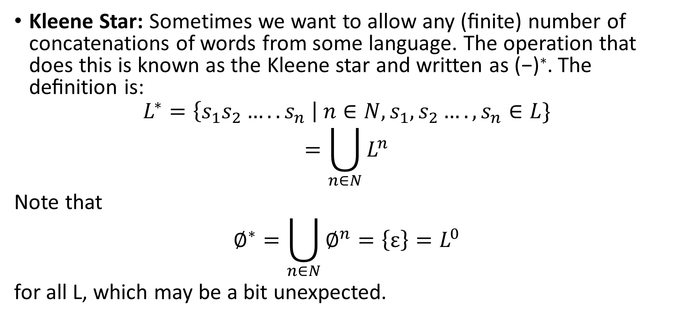
Deﬁning new languages from old ones
Kleene Star: Sometimes we want to allow any (ﬁnite) number of concatenations of words from some language. The operation that does this is known as the Kleene star and written as (−)∗. The deﬁnition is:
$$L^{∗}=\left\{s_{1}s_{2}…..s_{n} \right| n∈N,s_{1},s_{2}….,s_{n}∈L\}$$
$$=\bigcup_{n∈N}{L^{n}}$$
Note that
$$∅^{∗}=\bigcup_{n∈N}{∅^{n}=\left\{ε\right\}=L^{0}}$$
for all L, which may be a bit unexpected.

Slide 44
Language Definition
The languages can be defined in different ways:
Descriptive Method
Regular Expression
Finite Automata
Deterministic Finite Automata
Non Deterministic Finite Automata

Slide 45
Descriptive Method
The language is defined in the form of set, describing the conditions imposed on its words.
Example:
The language L of strings of odd length, defined over Σ={a}, can be written as
L={a, aaa, aaaaa,…..}
The language L of strings that does not start with a, defined over
Σ ={a,b,c}, can be written as
L ={Λ, b, c, ba, bb, bc, ca, cb, cc, baa,bab,bac,bba…}

Slide 46
Examples cont.
The language L of strings of length 2, defined over Σ ={0,1,2}, can be written as
L={00, 01, 02,10, 11,12,20,21,22}
The language L of strings ending in 0, defined over Σ ={0,1}, can be written as
L={0,00,10,000,010,100,110,…}

Slide 47
Examples cont.
The language EQUAL, of strings with number of a’s equal to number of b’s, defined over Σ={a,b}, can be written as
EQUAL={Λ ,ab,ba,aabb,abab,baba,abba,…}
The language EVEN-EVEN, of strings with even number of a’s and even number of b’s, defined over Σ={a,b}, can be written as
EVEN-EVEN={Λ, aa, bb, aaaa,aabb,abab, abba, baab, baba, bbaa, bbbb,…}
Even= {2,4,6,..}

Slide 48
Examples cont.
The language INTEGER, of strings defined over
Σ={-,0,1,2,3,4,5,6,7,8,9}, can be written as
INTEGER = {…,-2,-1,0,1,2,…}
The language EVEN, of stings defined over Σ={-,0,1,2,3,4,5,6,7,8,9}, can be written as
EVEN = { …,-4,-2,0,2,4,…}

Slide 49
Examples cont.
The language {a^{n}b^{n} }, of strings defined over Σ={a,b}, as
{a^{n} b^{n} : n=1,2,3,…}, can be written as
a^{n} b^{n} ={ab, aabb, aaabbb, aaaabbbb,…}
The language {a^{n}b^{n}a^{n} }, of strings defined over Σ={a,b}, as
{a^{n} b^{n} a^{n}: n=1,2,3,…}, can be written as
a^{n} b^{n} a^{n} ={aba, aabbaa, aaabbbaaa, aaaabbbbaaaa,…}
The language {a^{n}b^{m}a^{n} }, of strings defined over Σ={a,b}, as
{a^{n} b^{m} a^{n}: n=1,2,3,… ; m=0,1,2,3,…}, can be written as
a^{n} b^{m} a^{n} ={aa,aaaa,aaaaaa,……, aba, aabaa,…}

Slide 50
Examples cont.
The language factorial, of strings defined over Σ={0,1,2,3,4,5,6,7,8,9}
factorial={1,2,6,24,120,…}
The language FACTORIAL, of strings defined over Σ={a}, as
{a^{n!} : n=1,2,3,…}, can be written as
{a,aa,aaaaaa,…}.
It is to be noted that the language FACTORIAL can be defined over any single letter alphabet.

Slide 51
Examples cont.
The language DOUBLEFACTORIAL, of strings defined over Σ={a, b}, as
{a^{n!}b^{n!} : n=1,2,3,…}, can be written as
DOUBLEFACTORIAL={ab, aabb, aaaaaabbbbbb,…}
The language SQUARE, of strings defined over Σ={a}, as
{a^{n2} : n=1,2,3,…}, can be written as
SQUARE={a, aaaa, aaaaaaaaa,…}

Slide 52
Examples cont.
The language PRIME, of strings defined over Σ={a}, as
a^{p} : p is prime}, can be written as
PRIME={aa,aaa,aaaaa,aaaaaaa,aaaaaaaaaaa…}

Slide 53
An Important language
PALINDROME
The language consisting of Λ and the strings s defined over Σ such that Rev(s)=s. It is to be denoted that the words of PALINDROME are called palindromes.
Example:
For Σ={a,b}, PALINDROME={Λ , a, b, aa, bb, aaa, aba, bab, bbb, ...}

Slide 54
Language called vowels , contain all the vowels
L={a,e,I,o,u}
Language containg loop keywords of c++
L={for, while, do while}
Language defined over Σ={a,b,c} where length of strings is less then equals to 2.
L={^, a,b,c, aa,ab,ac, ba,bb,bc, ca,cb,cc}
Language defined over Σ={a,b,c} where length of strings is greater then equals to 2.
L={aa,ab,ac, ba,bb,bc, ca,cb,cc, aaa,aab,aac,…}

